Slide 1
The microarchitecture
I4GIC

Slide 2
Functions and characteristics of instructions
It was already mentioned that the instructions directly executable by any processor are very primitive in nature. In general, they are as simple as: ‘copy a byte from here to there’ or ‘add contents of these two registers’, or something similar to these.
In general instructions can be placed in 3 categories:
Data move type instructions
Arithmetic and logical instructions
Program ow control and machine control instructions.

Slide 3
Data move type
These instructions are most frequently used to copy data from one place to another. The source and destination of movements may be registers within the processor or some external memory locations or a combination of both.
Immediate data, presented as a part of the instruction, may also be loaded to some destination defined by these instructions.
Data is passed through the bus and note that internal CPU bus is much faster than external bus. That’s why data movement between registers-registers or between CPU’s components are always recommended.

Slide 4
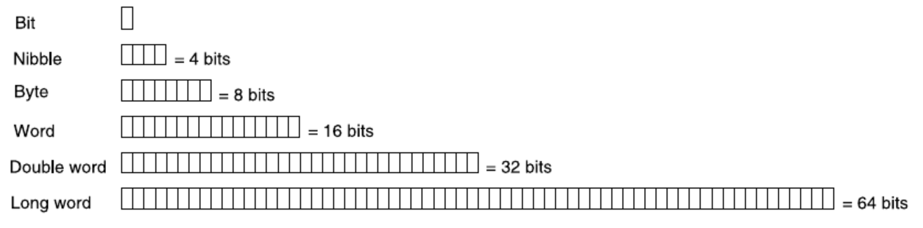
To be simple, CPU prefer handling data with the same size ( 8 bits or 16 bits or …) but in real practice it can handle different length of data. 8 bits CPU can normally handle 8 bits data, 4 bits data, 2 bits data and 1 bit data.
It is getting more complicated the more data length a CPU can handle but the possibility is there.

Slide 5
Arithmetic and Logical Type
Most processors offer instructions for four basic arithmetic operations (add, subtract, multiply and divide) with signed and unsigned integers and essential logical operations, e.g., AND, OR, XOR, NOT, with shift and rotate instructions.
These instructions normally required some status flags such as carry, signed, zero, …

Slide 6
Program Flow Control Type
Program flow control instructions form the third major group of processor instructions.
Generally, they are sub-divided as conditional and unconditional branching and subroutine call and return.
Branching instructions act depend on the status registers (flags)
Carry and zero are most widely used branching conditions. Instructions related with branching as per the condition of carry flag or zero condition are offered by all processors

Slide 7
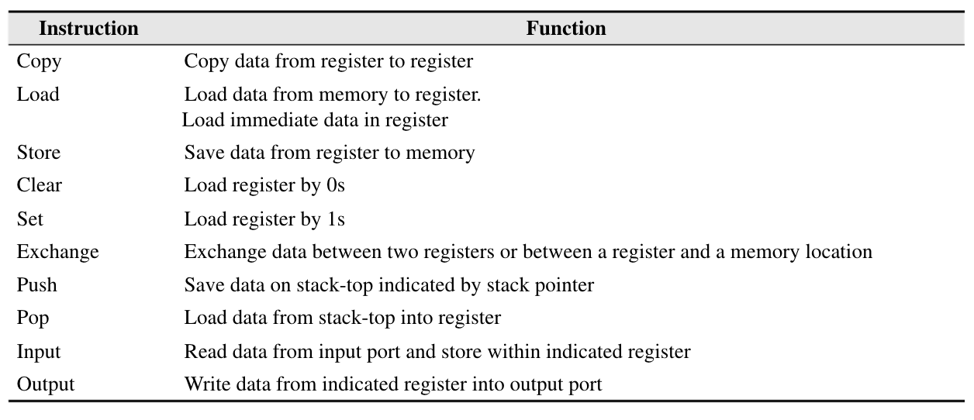
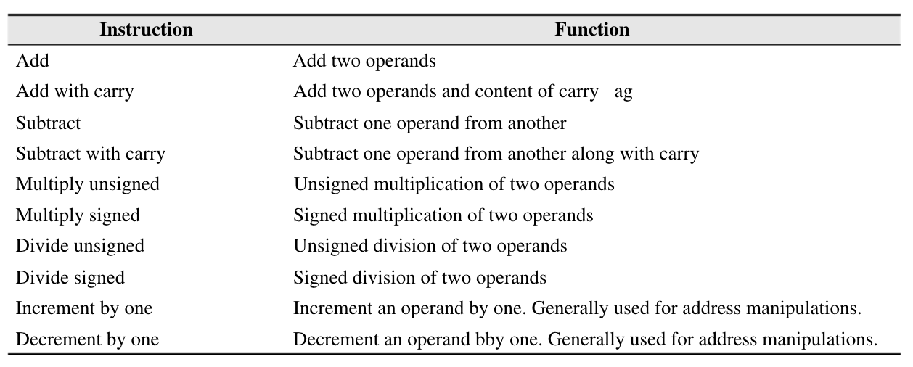
Common data transfer type instructions for processors
Common arithmetic type instructions for processors

Slide 8
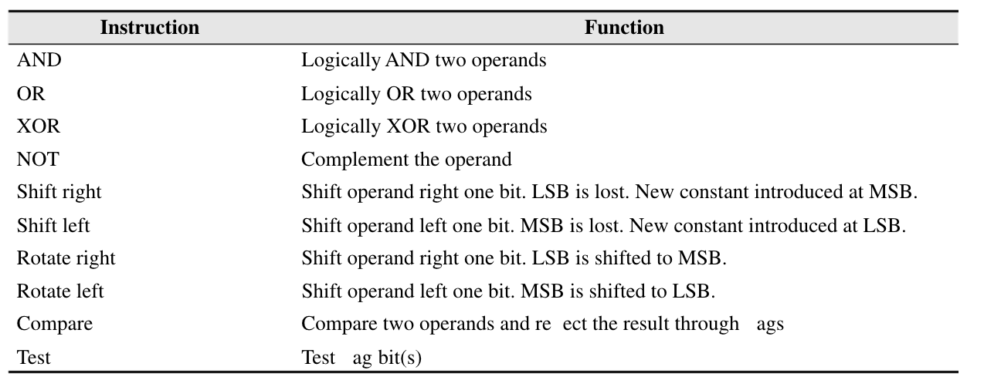
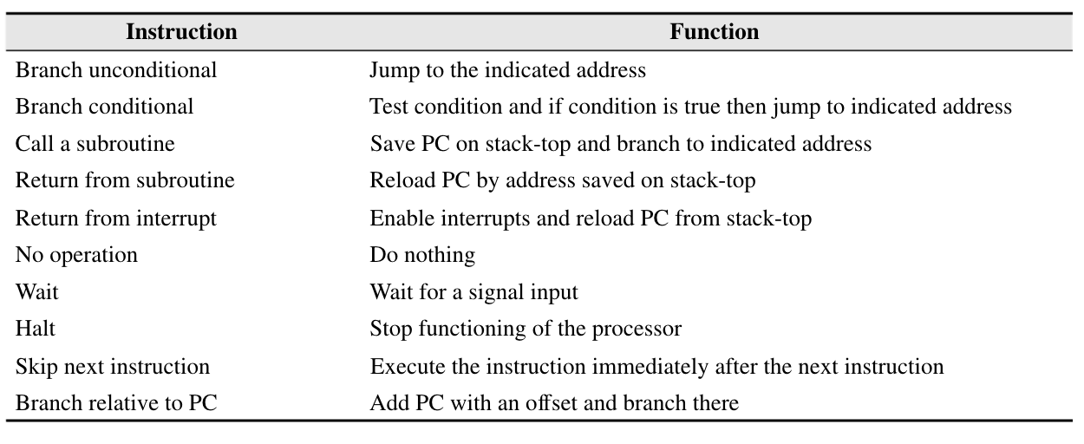
Common logical type instructions for processor
Common program flow control type instructions for processors

Slide 9
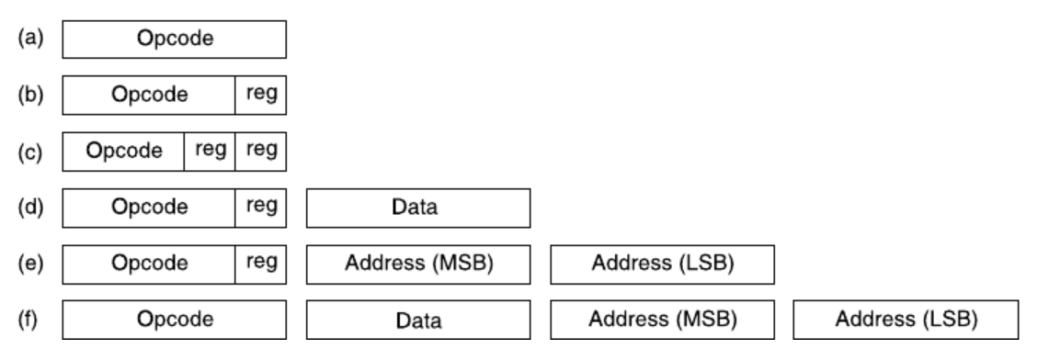
Schematic of a few formats of instructions
In general, an instruction is always transferred or store once together. But it is also possible to do so in different transaction or locations. Anyway, it is going to be complicated so avoid it unless you don’t have the choices.

Slide 10
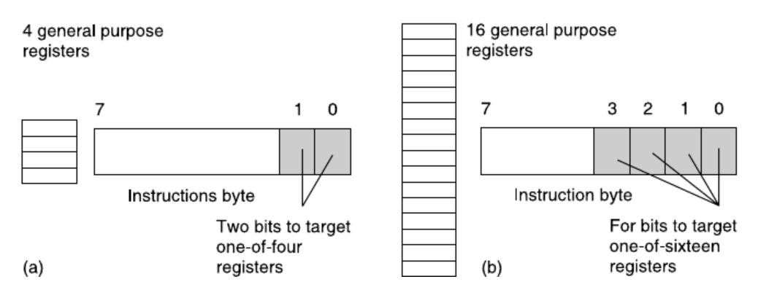
Register field variation for processor with (a) four and (b) sixteen registers

Slide 11
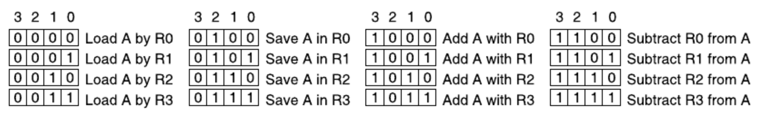
Let’s imagine we have the following combination
1. Set your expectation

Slide 12
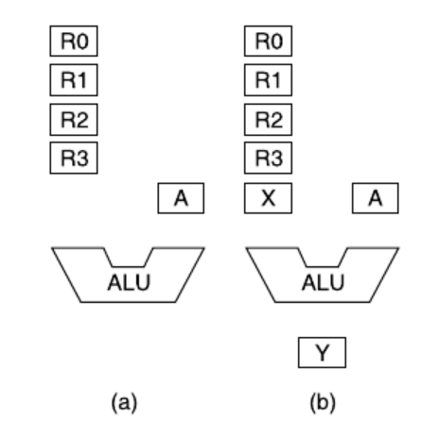
2. Visualizing Data-flow and Registers
Our ALU will have two input registers and one output register. We have designated the accumulator (register A) as one of the two input register for the ALU. Therefore, we shall need one more input register and we designate that register as X, which would be a temporary register. To hold the output from the ALU, we include another register in our design, say register Y. Both X as well as Y would be 4-bit registers, like all other registers in our example case
Register organization

Slide 13
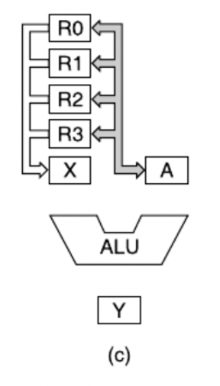
3. Data Path Design
The next step is to provide all necessary paths so that the data can ow properly from one register to another as per our requirements.
Considering first two instructions, we note that we must provide a bidirectional data path between the accumulator and all four registers, so that accumulator may be loaded from any register or may be stored in any register.
For addition and subtraction operations, apart from accumulator, another set of data must be available in the temporary register X, which should be copied from the indicated register as per the instruction. Therefore, there must be another bus connecting the temporary register X with all four registers from R0 to R3.
This data bus would be unidirectional , from register-set (R0 – R3) to X-register as in no case data would be copied from this temporary register (X) to any other register (R0 – R3).
Bidirectional data path of accumulator

Slide 14
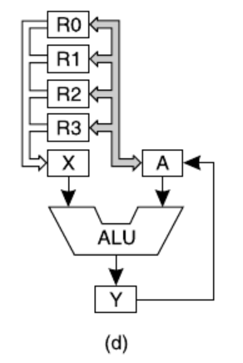
To start with, note that we have not provided any mechanism of loading any immediate data (using immediate addressing mode) to the accumulator or four other registers (R0 – R3), for the purpose of focusing on essential issues.
Next, we have avoided indicating any flag register, which is considered to be essential for any ALU, for keeping the problem a simple one. Furthermore, the data path, provided by us is not an optimum one, but takes care of all necessary data flow, as per the demand of our initial assumptions regarding the problem.
In total, we have provided six data paths. Only one of these six paths is bidirectional, and the remaining five are unidirectional. Note that the bidirectional data path is also capable of copying the data from any register (R0 – R3) to another register (R0 – R3), which we are not implementing for our present example problem.
From accumulator, there are three different data paths. One is the bidirectional data path for registers R0 – R3. The second one is from the accumulator to the ALU. The third one is to the accumulator from Y register. These last two paths would be used only during the ALU operations.
From each of the four registers (R0 – R3), there are two data paths, one for communicating with the accumulator and another to move the selected register’s data to X-register. The second path would be necessary before any ALU operations.

Slide 15
For the X-register, two separate data path exists, one to get the data from any one of the four registers R0 – R3. Another one is to load it within the ALU. For Y-register also there are two separate data paths, one to receive the result from ALU and another to send the data to the accumulator. All these ensure that we have provided adequate data paths to maintain the data ow, as per the requirement of the problem statement.
4. Control signal requirement
To make our unit a working one, we need to design all necessary control signals for data propagation or proper sequential flow of data.
What is a control signal?
In this case, control signal indicates those signals whose change of logic level would allow or disallow (enable or disable) the data flow from one point (register etc.) to another.

Slide 16
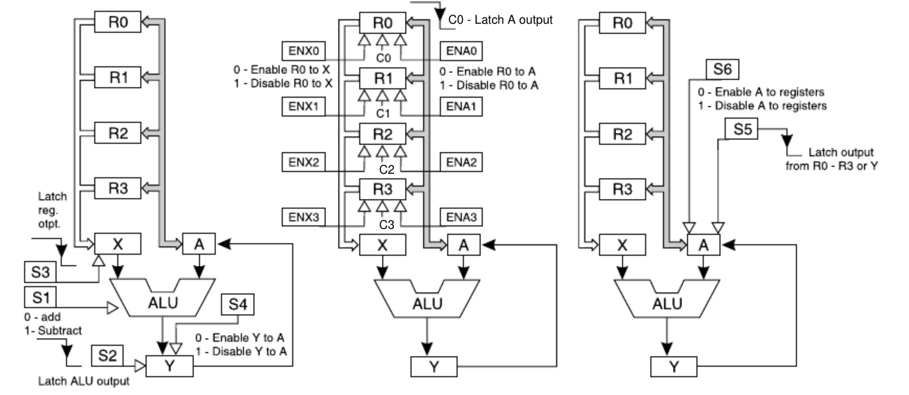
Notes:
Let us start our discussions on control signal design with the ALU. What should be its control signals? If we provide a static ALU with combinational logic, as we have designed in Example 3.3 of Chapter 3, then, for the present problem, the only control signal necessary is to indicate whether the ALU has to perform addition or subtraction. As there are two states for each digital signal (1 and 0), only one control input is suf cient for the ALU, whose 0 state would denote addition and 1 state would
indicate subtraction. Let us designate this control signal as S1. Incidentally, it matches with bit 2 of our
designed opcodes. However, later we shall see that bit 2 of the opcode alone cannot be directly used to
activate the ALU for distinguishing between addition and subtraction.
Now let us consider the ALU-result register (Y). In this case, we nd that its major requirement is a
latching signal to latch the ALU output. Therefore, one control signal, e.g., S2, is necessary for register
Y and we assume that its falling edge would latch the output from ALU within Y register. There should
be an enabling signal to make the output from Y to be available in the accumulator. If the output from
this register (Y) is always available to the accumulator (A), then the latching signal for accumulator may
not be able to latch the correct input for the accumulator as there is another input from general purpose
registers (R0 – R3), and there cannot be more than one latching signals for one register. Therefore, we

Slide 17
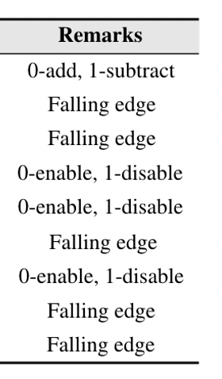
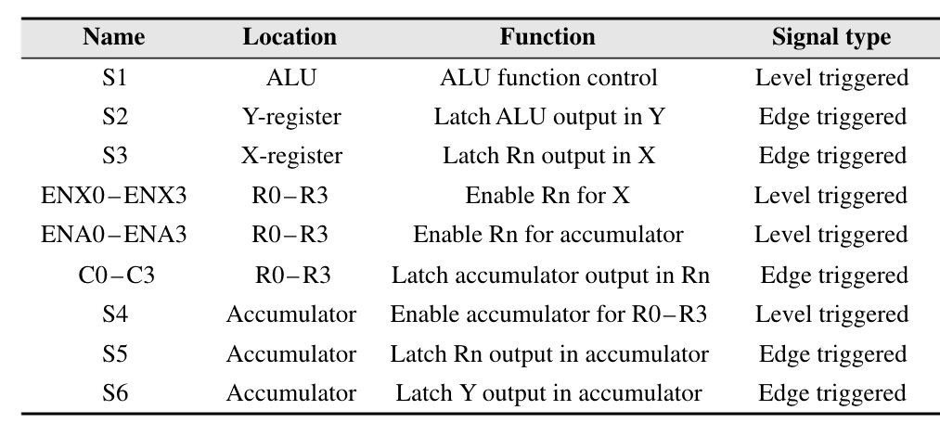
Summary of control signals

Slide 18
4. Need micro instructions
What is meant by microinstructions?
To implement any instruction, several steps would be necessary. These steps are designated as micro-steps and the necessary instructions to generate these micro-steps are known as microinstructions.
For example, let us take the first instruction: Load accumulator by a register and assume that the instruction is referring a general purpose register R0. We find that the following micro-steps (and sequence) are necessary to implement the instruction Load accumulator by R0:
Make ENA0 as 0 to enable output of R0 to reach accumulator.
Latch the input from R0 to accumulator by a high to low signal at S5.
Note that the sequence is also important in this case. If we activate S5 first and then activate ENA0, we
shall not be able to receive the correct data within accumulator.

Slide 19
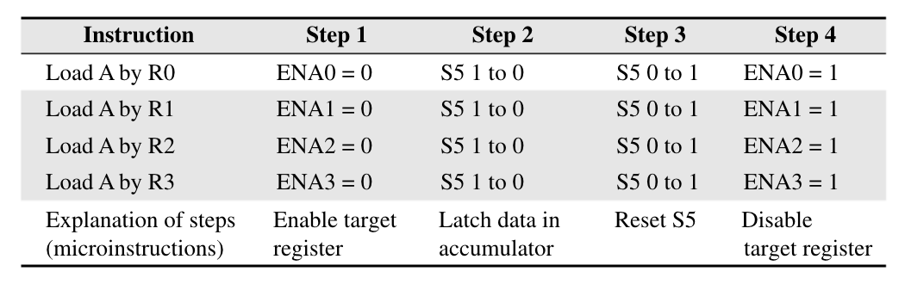
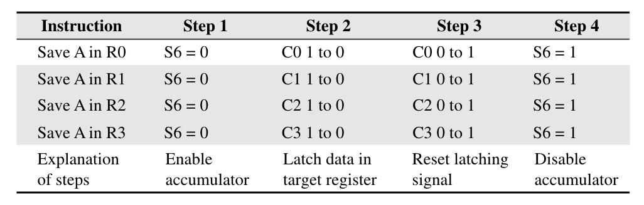
Micro-steps for Loading Accumulator
Micro-steps for saving accumulator

Slide 20
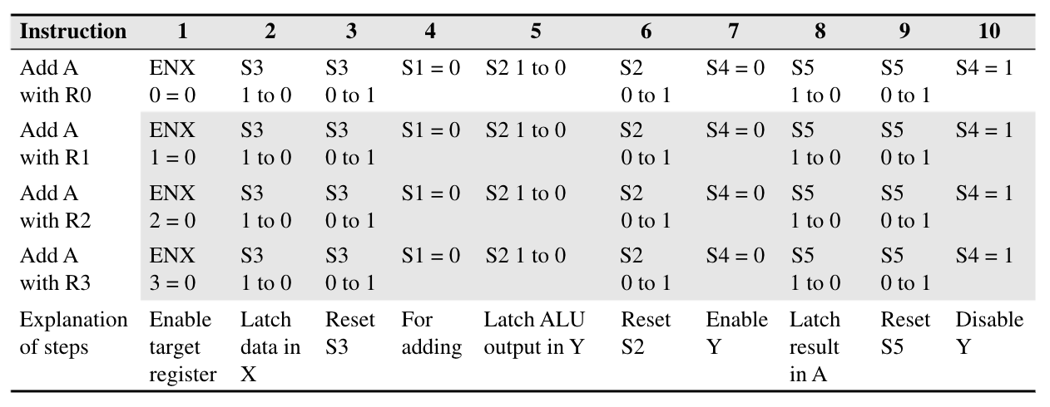
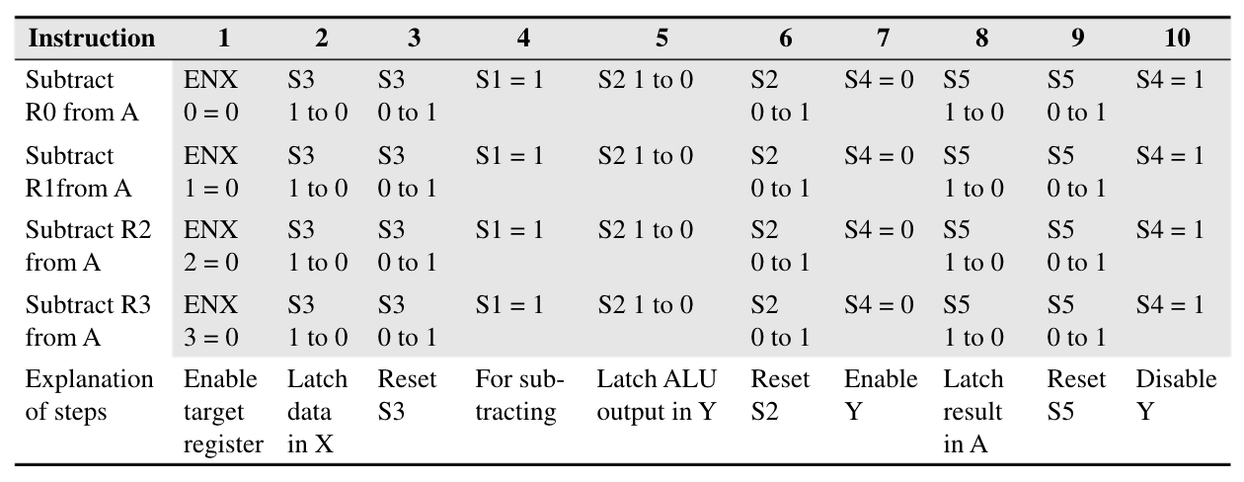
Micro-steps for adding accumulator with a register
Micro-steps for subtracting a register from accumulator

